Slide 1
HW1 - Matrix Multiplication
First, input m, n, p, which is the dimension of two matrix, A_{m*n}, B_{n*p}.
Then, input the two matrices respectively with row major.
Finally, output the multiplication of A and B.
Input: m, n, p(max dimension is 10), two matrices(A, B)
Output: A*B

Slide 2
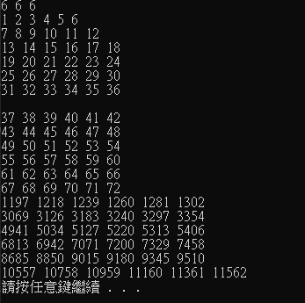
HW1 - Reference output

Slide 3
HW2 - Position
Determine the positions of each letter in a given string.
Input: A string containing only english characters (capitalized and not capitalized)
Output: The positions of each letter in order A~Z, then a~z

Slide 4
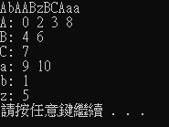
HW2 - Reference output

